Slide 1
Language variation: sociolect, register, social class. Slang. Internet communication
Lecture 2
Prof. Anna Verschik
12.09.2025

Slide 2
Linguistic variety or lect: the term used when language status, prestige, codification etc. is irrelevant for the discussion
Language is not a discrete entity with clear borders, varieties may have many things in common (our idiolects may be similar but not identical; think about transitional dialects etc.)
My metaphor: Language is not like a tile, it is more like jelly

Slide 3
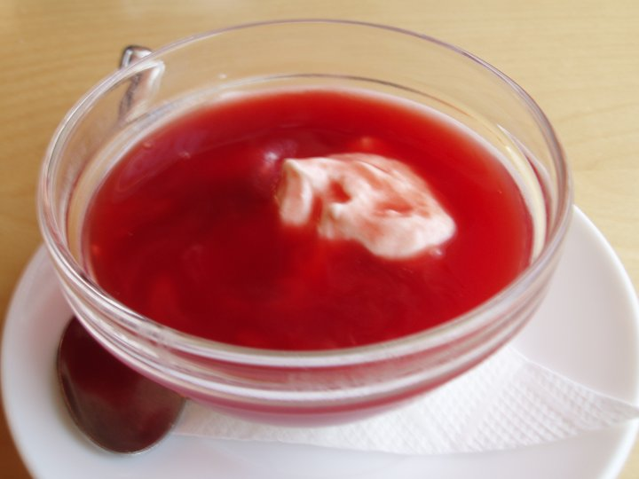
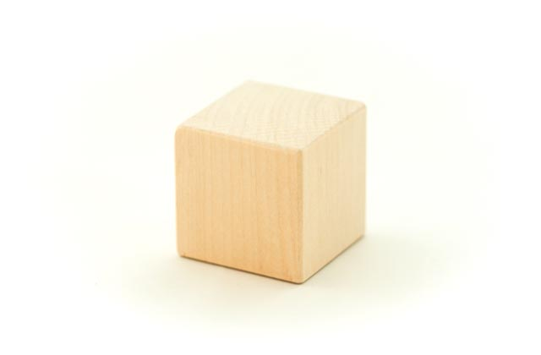

Slide 4
Variety is not identical to itself in time
Geoffry Chauser (1343-1400), The Canterbury Tales Middle English Whan that Aprill, with his shoures soote | Modern English When [that] April with his showers sweet
The droȝte of March hath perced to the roote | The drought of March has pierced to the root
And bathed every veyne in swich licour, | And bathed every vein in such liquor,
Of which vertu engendred is the flour; | Of which virtue engendered is the flower;

Slide 5
… and in space
Think of British, USA, Canadian, Australian English
Think of Singapore, Indian, Irish English
Think of local dialects (Yorkshire, Oxfordshire)
Think of English as lingua franca (common language either when nobody speaks each other’s language and uses a third one or it is a native language for one speaker but not all)

Slide 6
Language is always changing
What is right? Is there good language?
How to define what a mistake is? Consider these examples
I ain’t got no money
He right
She is go home
“Right” version is a convention. Society agrees what counts as a norm (spelling, grammar, pronunciation). Norm can be changed if it does not correspond anymore to the actual usage and speaker’s perception
Standards are not objectively good or right, although some people cannot live with this idea

Slide 7
There are no objective reasons why Northern Estonian variety became the basis of Modern Standard Estonian.
Any variety can be developed into standard variety and codified
Reasons are extra-linguistics (more people understood NE than SE, SE became gradually limited to religious texts etc.)
Regional and historical change will always exist
Individual variation
Situational variation (depends on domain, topic etc.)

Slide 8
Polycentric standards
English is a fine example thereof
What variety of English is better? Is Singapore English “erroneous” compared to British Standard English?
Some people may think this is the case because there was language shift (from another language to English) and learner’s varieties emerged (i.e. “bad” English of learners)
But it is about aesthetics and taste and not about objective characteristics
Laypeople think that older varieties are more “right” but it is not so

Slide 9
Written vs. oral language
Is written = formal and oral = informal?
Divisions differ across language communities
Proximity or distance between written and oral language differs
In some cultures the distance is upheld on purpose
Computer-mediated communication (CMC) breaks up written vs. oral dichotomy, it affects our understanding of formality in some genres (see below)

Slide 10
Different degrees of formality/politeness
Some systems are very simple and some are complex
It is important how the speaker’s choice is perceived (right or wrong). Even relatively simple conventions (French tu – vous, Estonian sina ‘you, singular’ – teie ‘you’ polite/plural) may prove to be difficult
In Estonia rules of sina-teie are changing; more usage of sina; it is OK to use informal sina among colleagues even with a superior
In Russia no singular 2nd person pronoun is possible with unfamiliar and older persons. In Russian of Estonia the convention is changing and getting closer to that of Estonia

Slide 11
Choice of varieties
Everyone has a whole repertoire of varieties at his/her disposal
In some situations choice is quite restricted and in some not at all
In multilingual communication the range of resources is wider
Even if there is main language of communication, insertion of other language elements is possible (reference to the same context, common knowledge etc)
PhD student writes an e-mail to me (2013): „Hi Anna, when would be a good day to collect my juhendaja arvamus and get your signature to the aruanne? Also what room should I go to get the kinnitatud väljavõte läbitud ainetest?“

Slide 12
Situational variation. Register
Language use may be conditioned by 1) user’s background („who I am“) and 2) situation („what I am doing now”)
„Who I am“ – for instance: Estonian, urban dweller, with vocational training, grown up in Southern Estonia and with access to South Estonian varieties (regional and social dialects, idiolects)
„What I am doing now“ – for instance: talking with a colleague about work but in an informal setting; presenting an academic paper, filling in a form (very little freedom and variation) (registers)
(1) user-based varieties (regional and social dialects etc)
(2) situation-based varieties (registers) – sometimes labelled as genres, styles (different authors use different terms but register is used mostly))

Slide 13
Examples of registers
Written
Oral (may also be quite formal, for instance, festive speech)
Everyday communication
Official (not always written, may be oral)
Edited (articles, prepared speeches)
Not edited (spontaneous)

Slide 14
Sociolect
User-based variety, sometimes called social dialect
In some societies social background determines language use; in some societies division between urban and rural language use (i.e., typical regional dialects opposed to standard/urban speech)
Urban dialects (in Germany large urban centres have their own varieties, i.e. Kölsch – urban dialect of Cologne etc.)
UK, USA – social stratification is important, sociolects are developed
In Estonia – no clear sociolects. Urban dialects? Not very clear, no research

Slide 15
Why there are no sociolects in Estonia?
Of course, different social groups use different varieties but the differences are not very pronounced
Especially comparing to the Anglo-American world
Before WWII - the main dichotomy between rural dialects and urban speech (of course, there was a social component to it but less clear)
Language policy in the independent Estonia was egalitarian (standard language should be available to everybody, speakers of minority languages and dialect speakers alike)
Relatively young standard language, people with late modernisation (as in many East European nations).
No aristocracy of Estonian origin who would set a standard (cf. French aristocracy forming the basis of Standard French, the language of Paris in 17th c).

Slide 16
Regional dialects today
Have Estonian dialects disappeared (due to media, internet, compulsory education, books, urbanization, negative attitudes)?
Strong regional identity (Võrumaa, Setumaa, islands) > facilitate maintenance?
Dialects do not exist in their previous form (change as any varieties) but they have not disappeared altogether
Regional accents (not accent in foreigner speech) – some features of dialectal origin that appear in common Estonian (something like: common Estonian with Tartu regional accent)
Paradoxically, some speakers use regional features when they communicate with neighbours etc and speak at home a more neutral variety of common Estonian

Slide 17
Language and gender
Highly politicized topic (not going into this)
Some differences are biologically conditioned (yes, not everything is social construction!), for instance, voice characteristics
Differences may be more or less pronounced in different societies (first observations made by ethnographers)
In some cultures gendered varieties are very different (even different morphology, for instance, some registers in Japanese); no such differences in Estonian

Slide 18
Sociocultural stereotypes: British “talking like a lady”
Some research: William Labov (1966) – women tend to be hypercorrect and prestige oriented
Peter Trudgill (1972) – covert prestige: for instance, British working class varieties are not valued by educational system but are valued among the users.
James and Lesley Milroy (social network, critique of Labov): even within the same social group there are many differences, not necessarily men vs. women but younger vs. older speakers. Men tend to be solidarity oriented, group pressure is stronger
Many textbooks of sociolinguistic repeat the idea (women – prestige oriented, men – solidarity oriented) but this is not true about every society.

Slide 19
Dalia Pinkevičienė (2022) Mixed speech styles in two single-gendered occupational groups: identities in interaction. Taikomoji Kalbotyra 17, 38-61
IT-company (male), cosmetics firm (female)
Men use English and Russian. English: specific items, terms; obsenities. Russian: obsenities.
Women: do not curse > no Russian! English: specific items, terms.

Slide 20
Prestige and covert prestige, stigmatization
Covert prestige (see previous slide) – not openly fostered/promoted by educators, language planners, elite etc.
It exists naturally because for many their way of speech is a part of their identity
Prestige is not the same as status! Language status: official, regional, top-down; prestige – what a group of speakers values, bottom-up
There may be conflicting prestige hierarchies within the same society
Stigmatization – creation of negative stereotypes (“only uneducated people use this word/form” etc). But even stigmatized words, forms and entire varieties do not disappear because of covert prestige

Slide 21
Slang
Often perceived as “bad language”
Is it sub-standard? Marginal variety (i.e., used by criminals)? Group variety? Terms like jargon, argot are used interchangeably but it is the same
Not necessarily marginal
Many varieties are non-standard (dialects, group varieties). “Sub-standard” has a negative connotation („something that is not the standard is of low quality“)
Is the difference only in lexicon or not only? Not very clear
Better to consider slang as an in-group variety or register. IT slang, doctors’ slang, student slang, road workers slang etc
Nobody’s only variety, probably, plays a role of register (when one communicates in-group only)

Slide 22
CMC
Is there an internet language?
CMC occurs in different environments and follow different type of logic > no one type of internet language!
Public/requires login; mono- or polylogue; mono- or multimodal (script only or script with video); moderated or not
Degrees of formalities can differ in CMC as well
Compare company blog vs. private blog
Or official Facebook page of a public person with private Facebook page

Slide 23
Official e-mail does not differ from a non-electronic conventional letter
Chat-room, forum talk is a relatively new way of communication. Includes features of oral and written language (abbreviations: OMG, LOL, Estonian vbla = võib-olla ‘may be’, tglt = tegelikult ‘really’, cities Tln, Trt)
It would be unproductive to say that CMC is bad and primitive; CMC offers another medium that changes the nature of communication
CMC is affected by the following parameters: real time communication or not; limited vs. unlimited space; genre (forum, group, vlog, blog etc); monologue vs. polylogue
Some genres have more common features with written language (blogs: not real time communication, unlimited space, monological)

